Slide 1
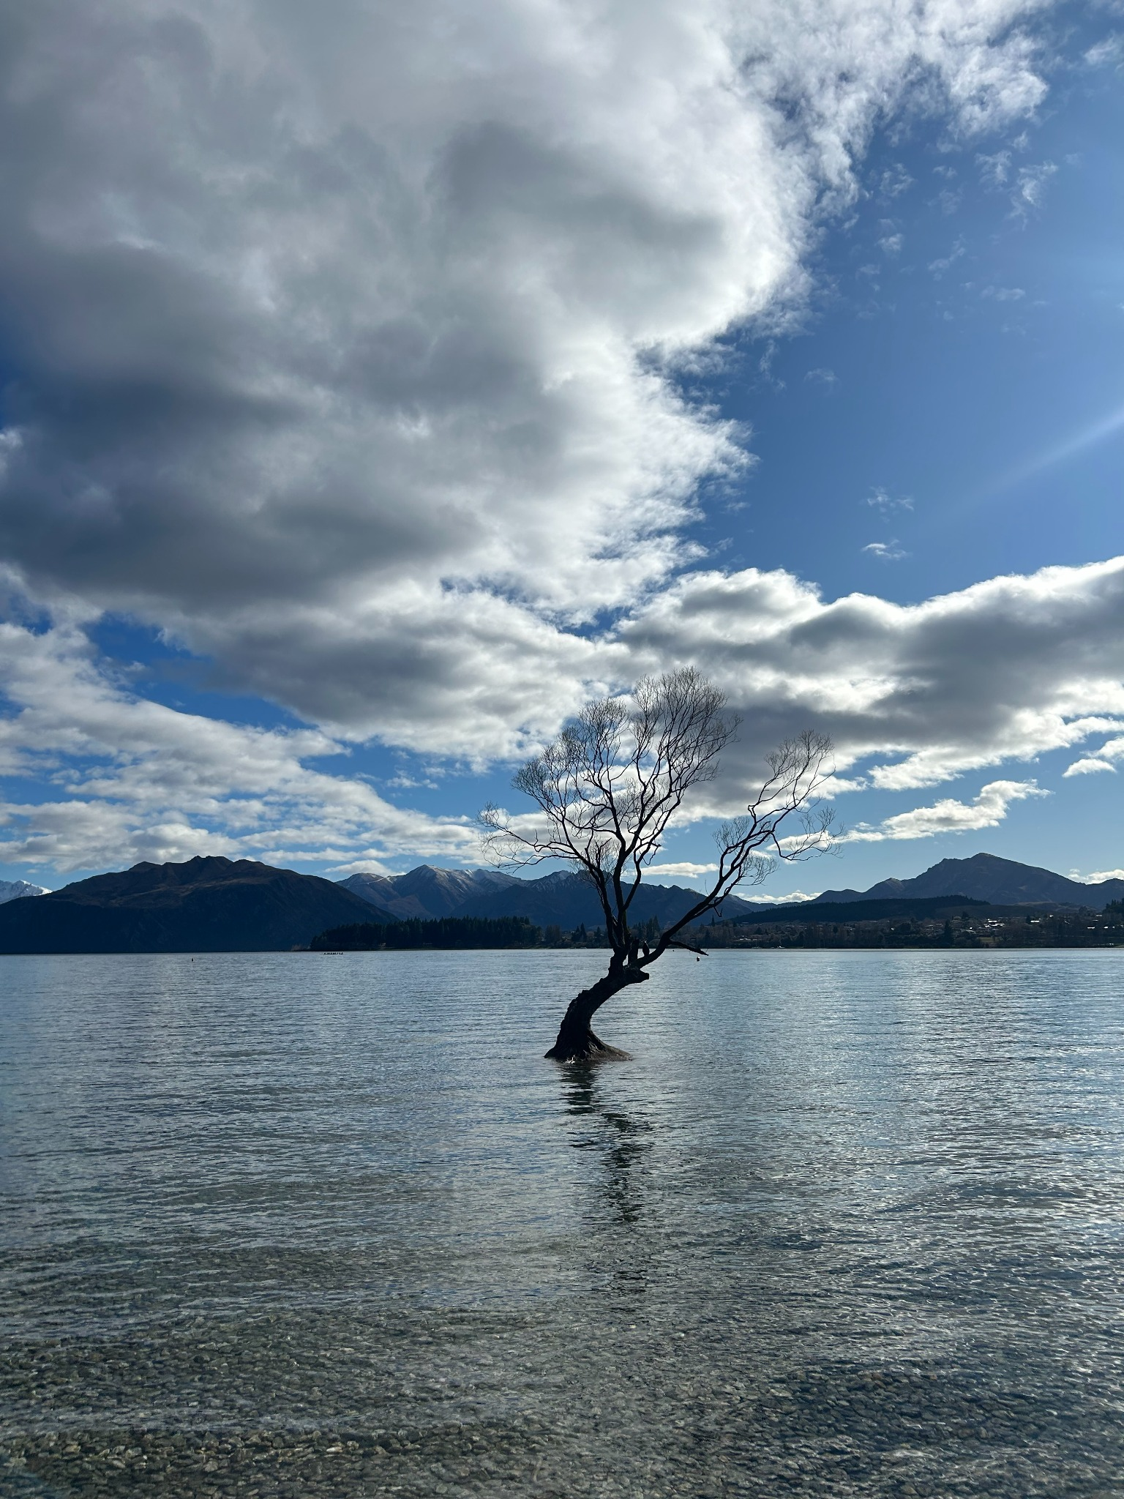

Wānaka Magic Visitor Accommodation Application
Neesh Ellis
Institute of Date – Software Engineering

Slide 2
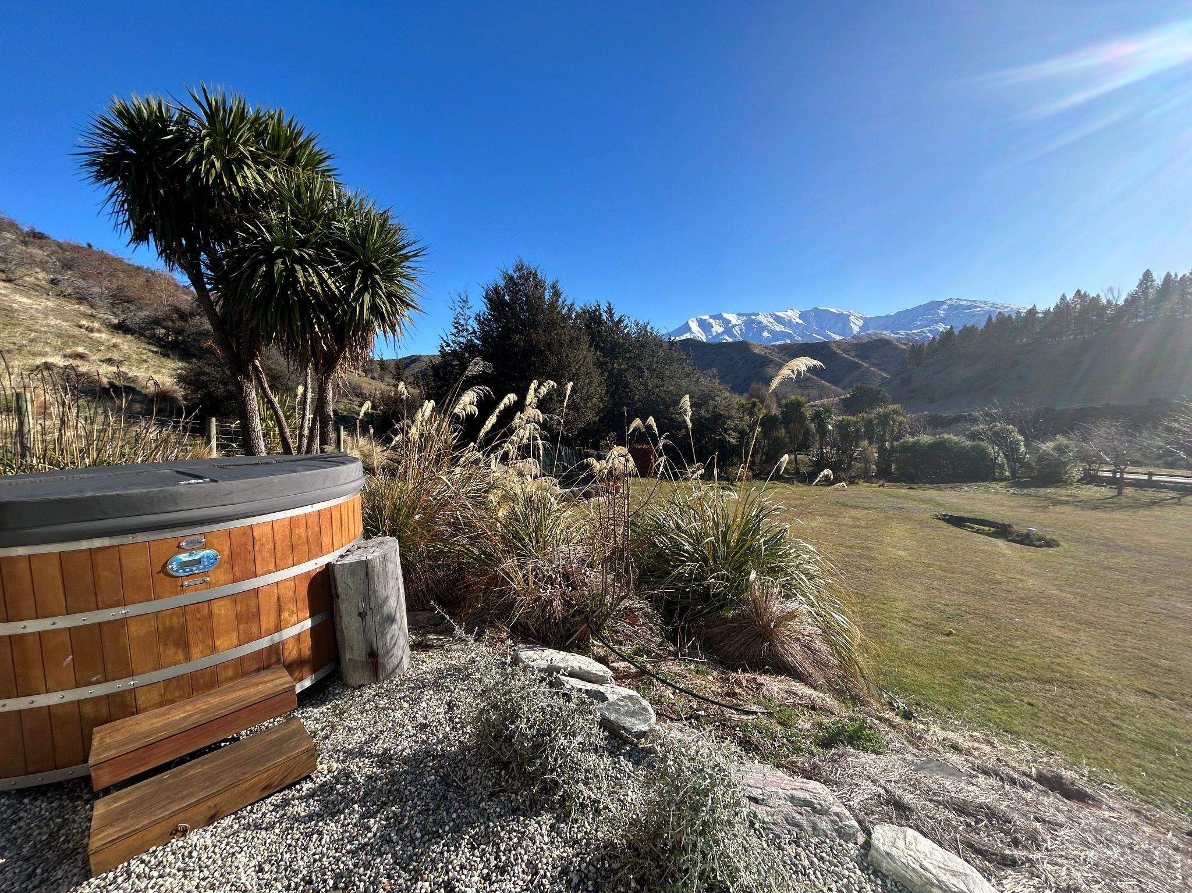
Industry Context
Tourism = NZ’s largest services export, 2nd only to Dairy overall
Airbnb: 57,000 listings in NZ (1,800+ in Wānaka alone)
Commission ~16% per booking – significant revenue drain
Goal: Boutique, locally designed solution reducing commission fees

Slide 3
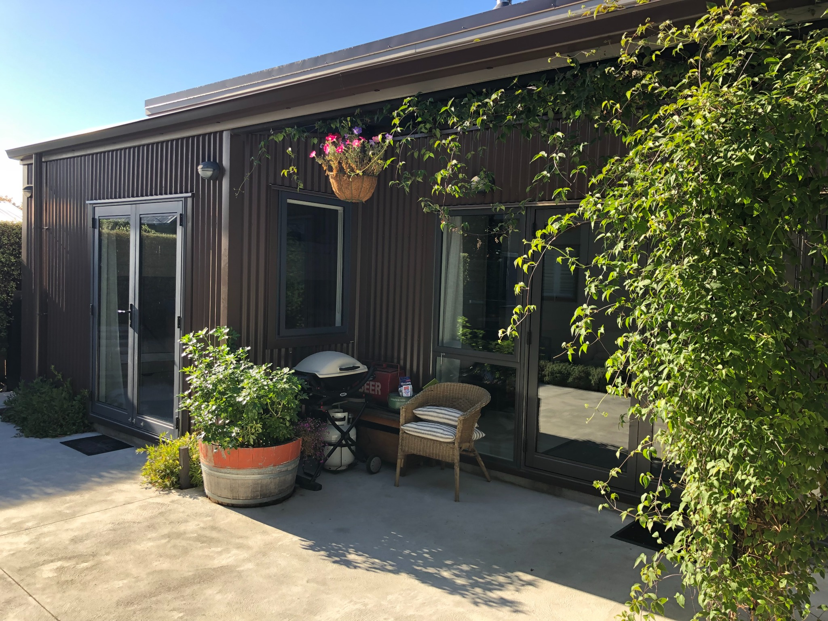
Stakeholders
Internal:
Owners
Property managers
Bookings, finance, marketing,
Manager of application
External:
Guests
Cleaners, laundry, gardeners
Tech partners: Airbnb API,
Windcave, tourism providers
Local council & tourism bodies

Slide 4
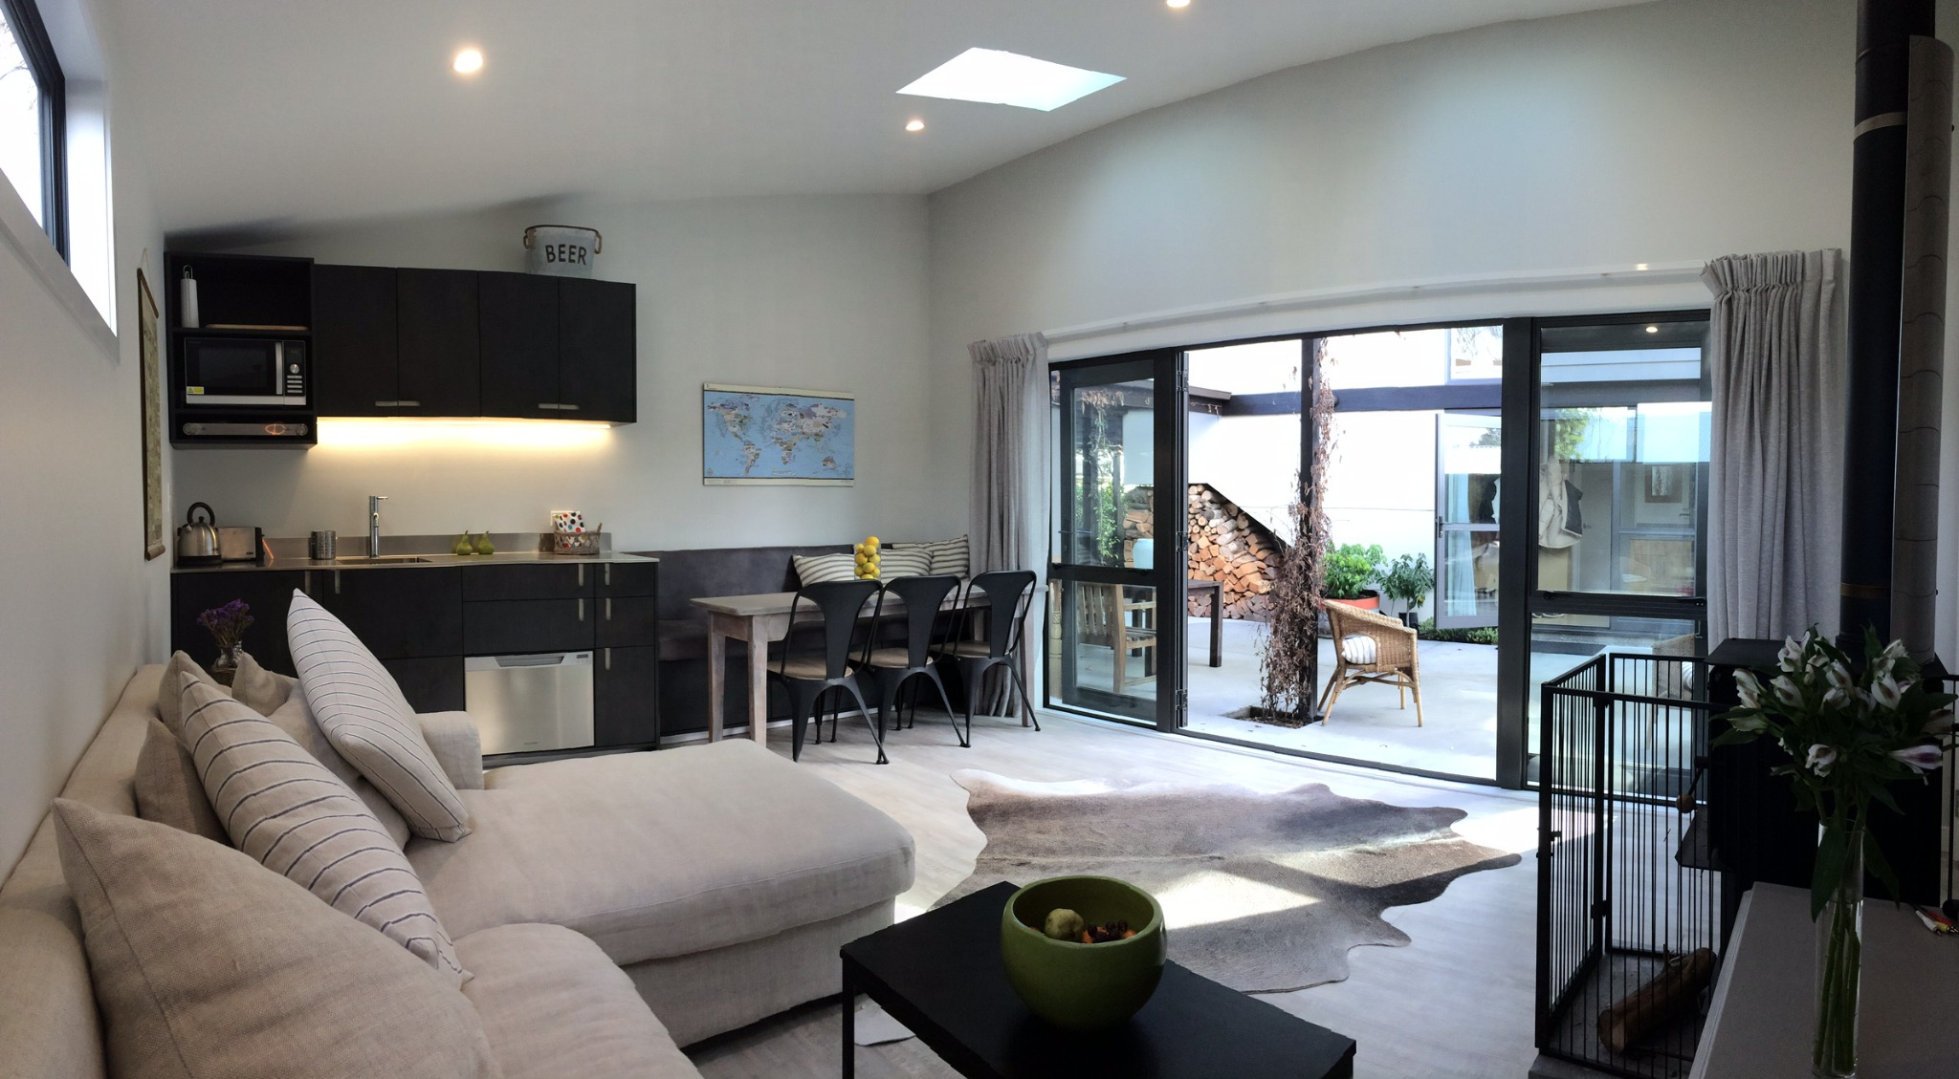
Product Features
Frontend Node.js application (6+ pages) using React & Vite
Navigation bar, login/sign-up, footer (tbc) using Mui Library
Accommodation showcase & booking calendar
Reviews panel with a goal to have real-time posting
Activities page &
inquiry form to book
Inquiry form – sales
channel

Slide 5
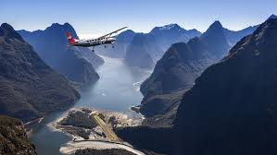
User Stories
National Tourist – quick booking, budget fit, close to skiing, unique accommodation
International Tourist – authentic local stay, activities, personal touch, boutique, customization
Business Traveler – reliable Wi‑Fi, flexible check‑in, direct booking, friendship with provider as travelling alone

Slide 6
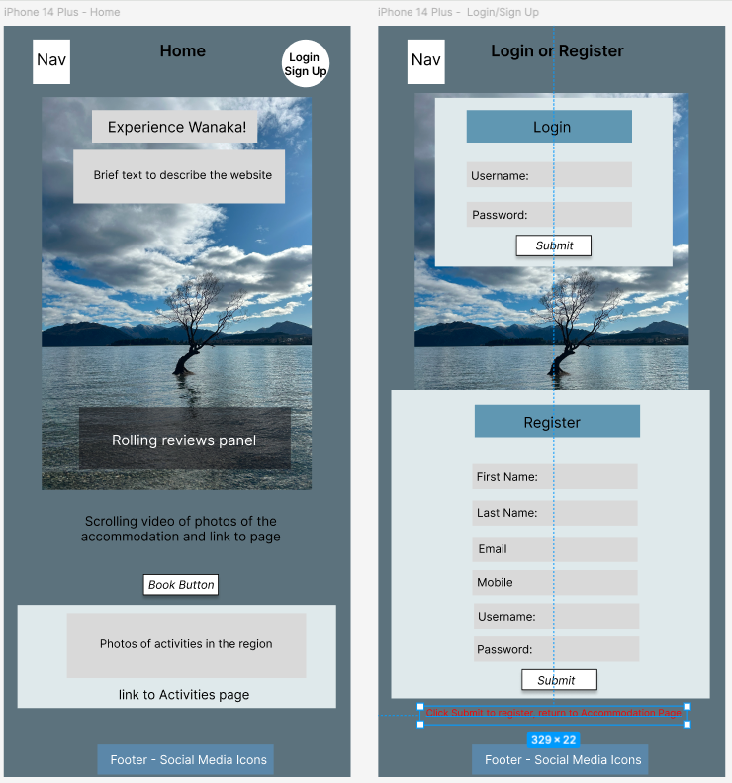
Development & Next Steps
Tools: Node.js, MVC architecture , Express framework for the backend. Next.js framework and React Library with Vite for the frontend application with MUI Library for components
Project management: Trello board
Logical & Physical database design using draw.io
JSON data file created using ChatGPT
Next steps: - create individual calendars for each property - complete the CRUD integration with frontend. - link my inquiries to registration for sales data - payment gateway integration - activities aggregator with commission model - integration with external bookings systems if required

